Slide 1
Advance Java
Training

Slide 2
JSP
JavaServer Pages (JSP) is a server-side programming technology that enables the creation of dynamic, platform-independent method for building Web-based applications.
JavaServer Pages (JSP) technology provides a simplified, fast way to create dynamic web content.
JSP have access to the entire family of Java APIs, including the JDBC API to access enterprise databases.
JSP technology enables rapid development of web-based applications that are server- and platform-independent.

Slide 3
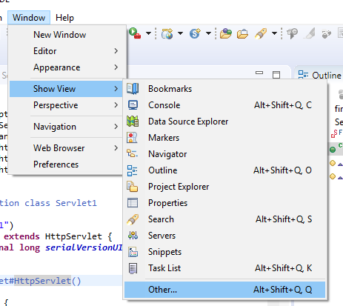
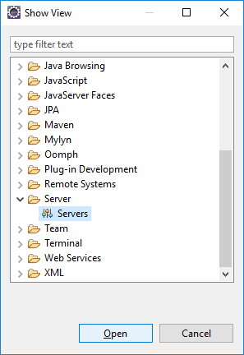

Step 1: Add server to Eclipse
Download Tomcat server 7, 8 or 9 :
http://tomcat.apache.org/download-70.cgi
Unzip the folder at desktop
Open Eclipse.
Close all previous projects.
Select Windows->Show view->Other…
Select Server->Servers->Open
We get the Server window Open at the same tab as output tab.
Click on the link to add a new server.
Add the same version of tomcat from the folder.

Slide 4
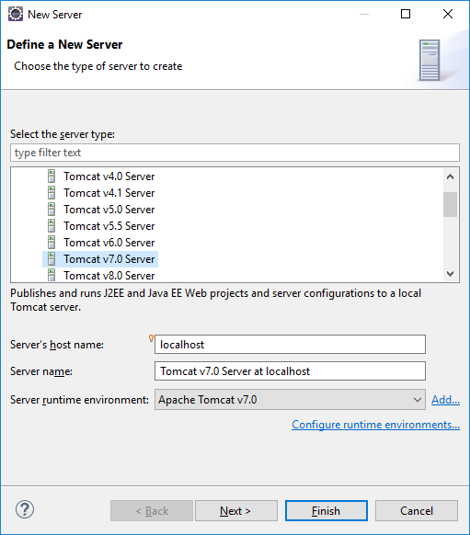
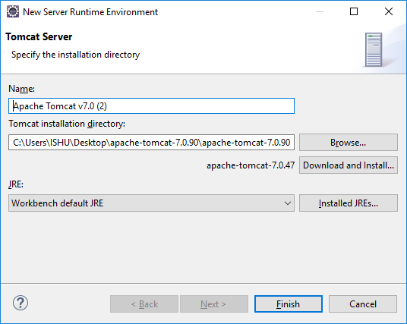

Step 2: Add Tomcat 7/9 server..
Click on link to add new server from server window
Select Apache->Tomcat 7/9 from Server type
Click Next
In New Server Runtime Window,
Browse to the tomcat folder
Click on Next.
Click on Finish.
The server is Added to Eclipse.
Right-click server to start, re-start or stop as needed.

Slide 5
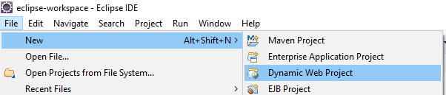
Add a Dynamic Web Project: First JSP Project
File-> New->Dynamic Web Project
Give the project a name: JSPEx1
Add runtime as the Tomcat 7
Click next
Click next
Select Generate web.xml descriptor
Click Finish

Slide 6
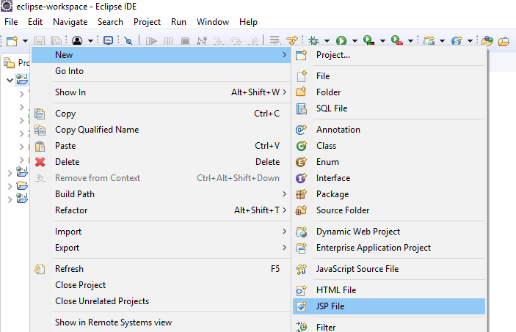
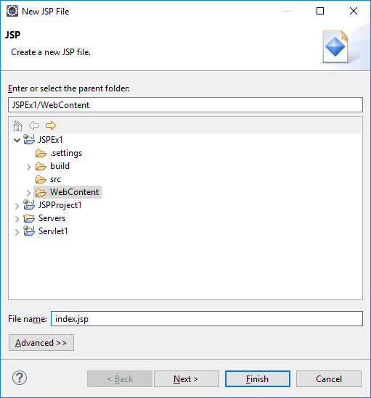
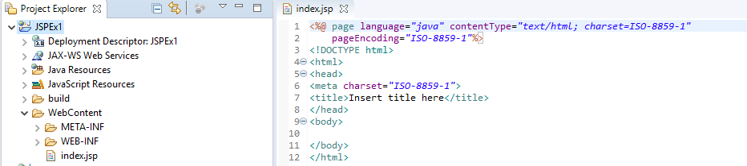
Add JSP to JSPEx1 Project
Right-click JSPEx1 project
New->JSP
Give file name: index.jsp
Click Next
Click Next
Click Finish
JSP gets added.

Slide 7
Edit the JSP Page:
<body>
<h1>HelloWorld!</h1>
</body>

Slide 8
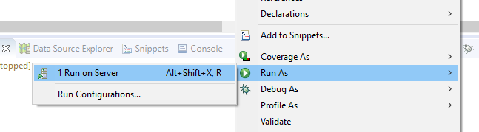
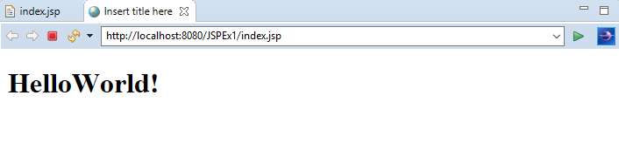
Running the first JSP
Once the JSP page is added, edit to add contents, then simply Run on Server
Click Next -> Finish->Restart Server if needed.
Check the output in the browser or eclipse default browser.

Slide 9
JSP Implicit Objects
Object | Description
request | This is the HttpServletRequest object associated with the request.
response | This is the HttpServletResponse object associated with the response to the client.
out | This is the PrintWriter object used to send output to the client.
session | This is the HttpSession object associated with the request.
application | This is the ServletContext object associated with the application context.
Config | This is the ServletConfig object associated with the page.
pageContext | This encapsulates use of server-specific features like higher performance JspWriters.
Page | This is simply a synonym for this, and is used to call the methods defined by the translated servlet class.
exception | The Exception object allows the exception data to be accessed by designated JSP.

Slide 10
Session
<html> <head> <title>UseSession</title> </head> <body>
<%
// Try and get the current count from the session
Integer count = (Integer)session.getAttribute("COUNT");
// If COUNT is not found, create it and add it to the session
if ( count == null ) {
count = 1;
session.setAttribute("COUNT", count);
} else {
count = count + 1;
session.setAttribute("COUNT", count);
}
// Get the User's Name from the request
out.println("<b>Hello you have visited this site: " + count + " times. </b>");
%>
</body> </html>

Slide 11
Control-Flow Statements
You can use all the APIs and building blocks of Java in your JSP programming including decision-making statements, loops, etc.
Decision-Making Statements
The if...else block starts out like an ordinary Scriptlet, but the Scriptlet is closed at each line with HTML text included between the Scriptlet tags.
Switch...case block has been written a bit differently using out.println() and inside Script-let
Loop Statements
You can also use three basic types of looping blocks in Java: for, while, and do…while blocks in your JSP programming.

Slide 12
Example: if..else
<%! int day = 3; %>
<html>
<head><title>IF...ELSE Example</title></head>
<body>
<% if (day == 1 || day == 7) { %>
<p> Today is weekend</p>
<% } else { %>
<p> Today is not weekend</p>
<% } %>
</body>
</html>

Slide 13
Example: Switch..case
<%! int day = 3; %>
<html>
<head><title>SWITCH...CASE Example</title></head>
<body>
<% switch(day) {
case 0:
out.println("It\'s Sunday.");
break;
case 1:
out.println("It\'s Monday.");
break;
case 2:
out.println("It\'s Tuesday.");
break;
case 3:
out.println("It\'s Wednesday.");
break;
case 4:
out.println("It\'s Thursday.");
break;
case 5:
out.println("It\'s Friday.");
break;
default:
out.println("It's Saturday.");
} %>
</body> </html>

Slide 14
Example: Loops
<%! int fontSize; %>
<html>
<head><title>FOR LOOP Example</title></head>
<body>
<%for ( fontSize = 1; fontSize <= 3; fontSize++){ %>
<font color = "green" size = "<%= fontSize %>">
Hello JSP
</font><br />
<%}%>
</body>
</html>

Slide 15
JSP Directives
A JSP directive affects the overall structure of the servlet class. It usually has the following form −
<%@ directive attribute="value" %>
There are three types of directive tag −
Directive | Description
<%@ page ... %> | Defines page-dependent attributes, such as scripting language, error page, and buffering requirements.
<%@ include ... %> | Includes a file during the translation phase.
<%@ taglib ... %> | Declares a tag library, containing custom actions, used in the page

Slide 16
import
The following packages are implicitly imported in a JSP file:
java.lang.*
javax.servlet.*
javax.servlet.jsp.*
javax.servlet.http.*

Slide 17
Example: page directive using “import
<%@ page language="Java" import="java.util.*,java.io.*"%>
<html>
<head> <title> Example 1 </title> </head>
<body>
<% Date now=new Date();%>
<h2> Server date and time is
<%=now %>
</h2>
</body>
</html>

Slide 18
End of JSP Basics
..Thank you

